Slide 1
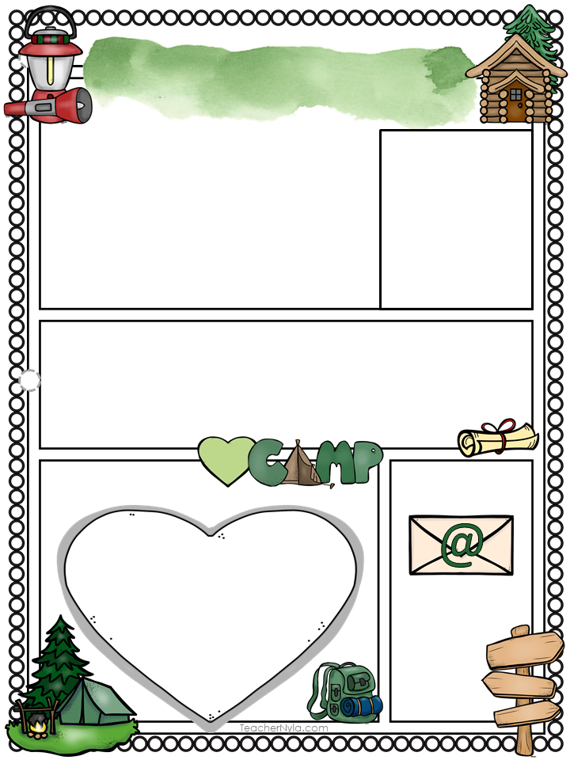
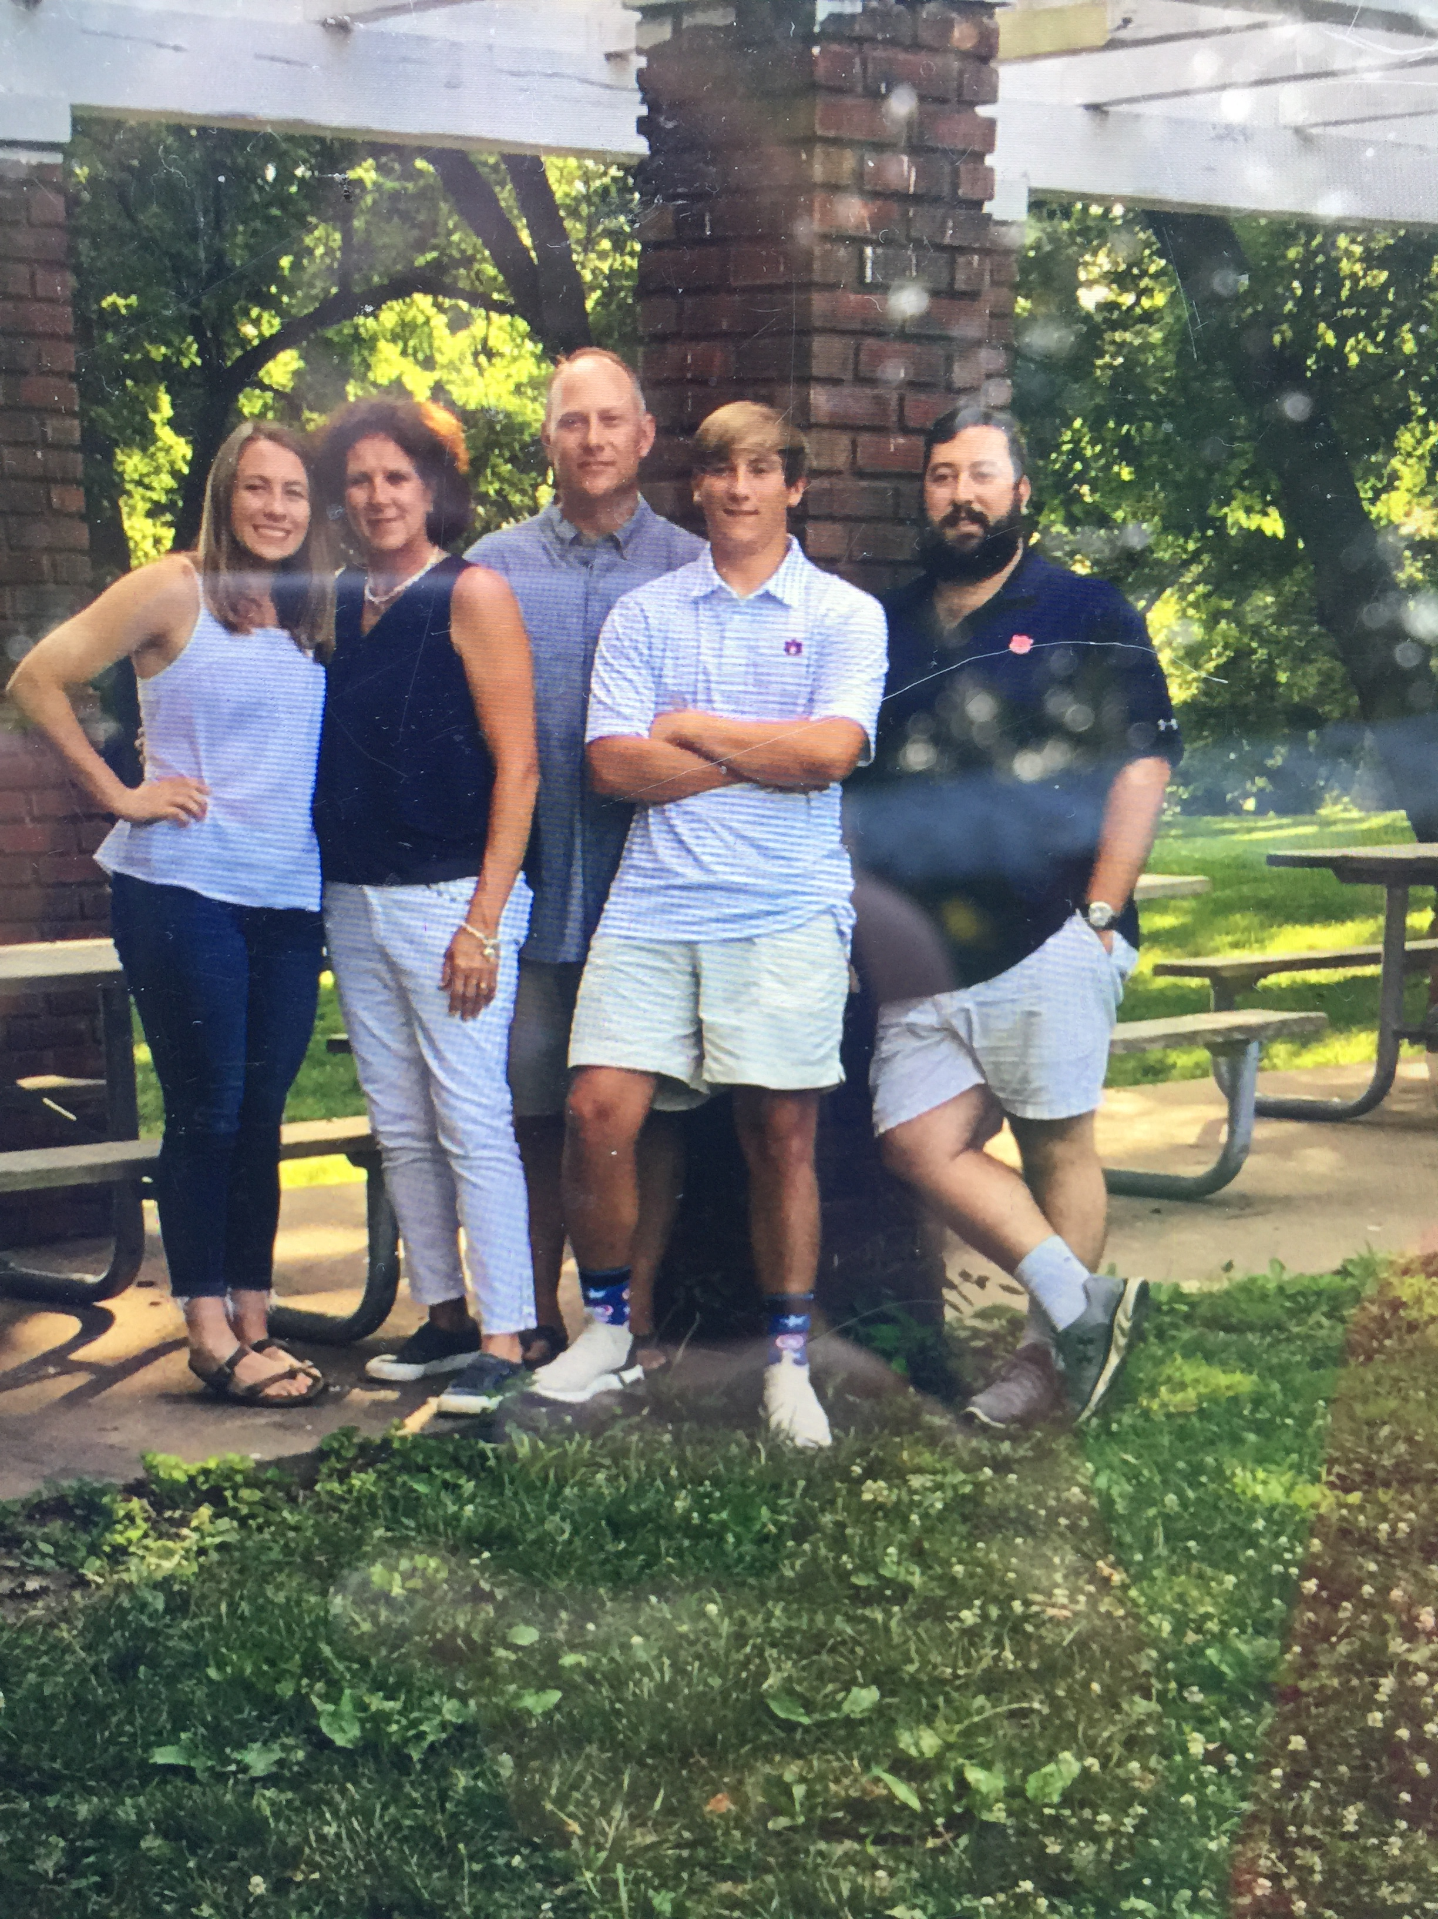
Mrs. Wall
WELCOME TO 5TH GRADE!!! YOU FINALLY MADE IT!!
I am excited to inform you that I will be your co-teacher along with Mrs. Paris. I will be teaching you Language Arts and Social Studies and Mrs. Paris will be teaching you Math and Science. Since we will not officially have a Meet the Teacher Night, we will have a WebEx Meet the Teacher. The 2 different times we have available are:
Aug. 6 11:30-12:00
Aug. 6 3:30-4:00
https://auburnschools.webex.com/meet/akwall
I can’t wait to meet you, I’m so excited to have the opportunity to teach you this year!!
Mrs. Wall
About Me
I am a wife to Eric, mom to 3 awesome children; Dalton, Shelby and Brendan, passionate fifth grade classroom teacher, and avid sports enthusiast. I hated school when I was in elementary school but the older I got the more I saw the importance of learning through experiences. I believe that the more you experience the more you learn. The classroom is one of the safest places you can experience things through reading and doing different activities. I can’t wait to share these experiences with you to Leave your Mark!!!!
My Favorites
Contact Me
Email me:
Call me:
887-4920 or
524-0719
Class Dojo
Subject: Social Studies
Book: The Bible
Hobby: DIY
Animal: Dog
Disney Movie: Fox and Hound
Holiday: Christmas
Season: Fall
akwall@
auburnschools.org

